Slide 1

User Data Protection
ASP.NET Core App

Slide 2

Project Summary
In this project we had made an authentication application based on ASP.NET. This project implements data security measures with web applications. The primary objective is to ensure data confidentiality and security of sensitive data by implementing proper authentication and authorization technique.

Slide 3




Team Members
Sarthak Pokharel
Parth Barvaliya
Ashmita Devkota
Aryan Radadiya

Slide 4

Project Demonstration

Slide 5
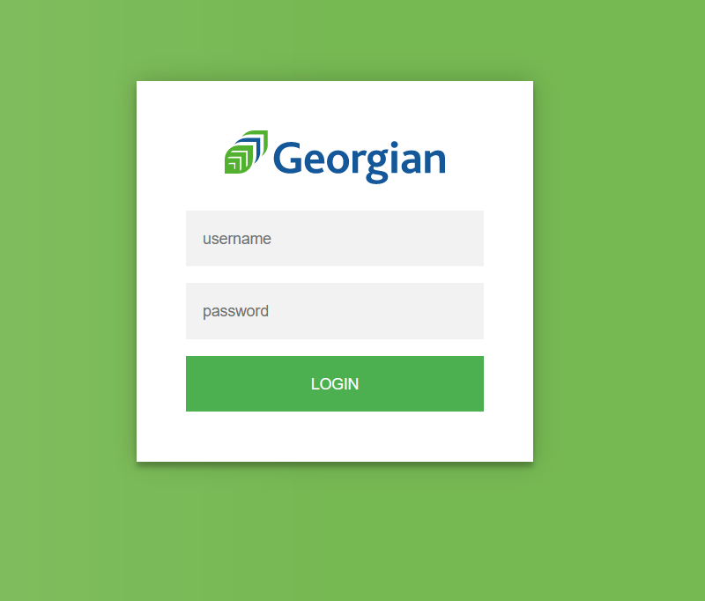
Login Page
All users can put in their username and password to log into the webpage.

Slide 6
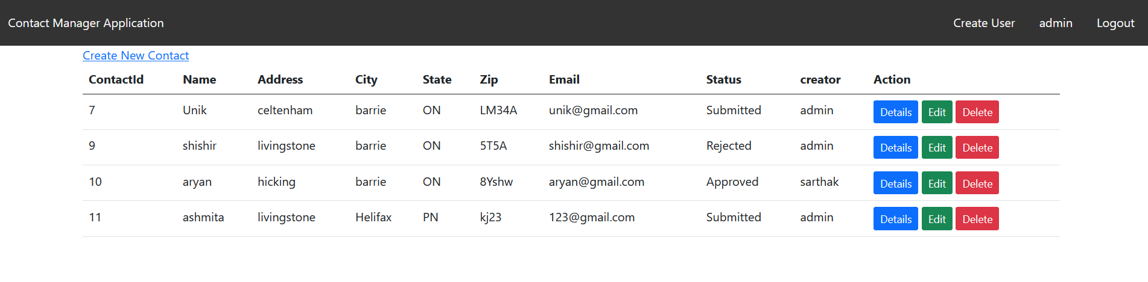
Admin Page
This page shows the number users that are assigned as Admins and show their details in a tabular format. We can also edit the users and create new admins/ users to the database or edit the details of the existing admins through this page.

Slide 7
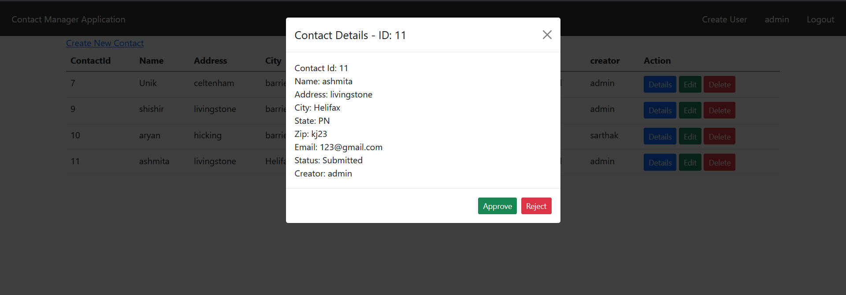
Admin Page

Slide 8
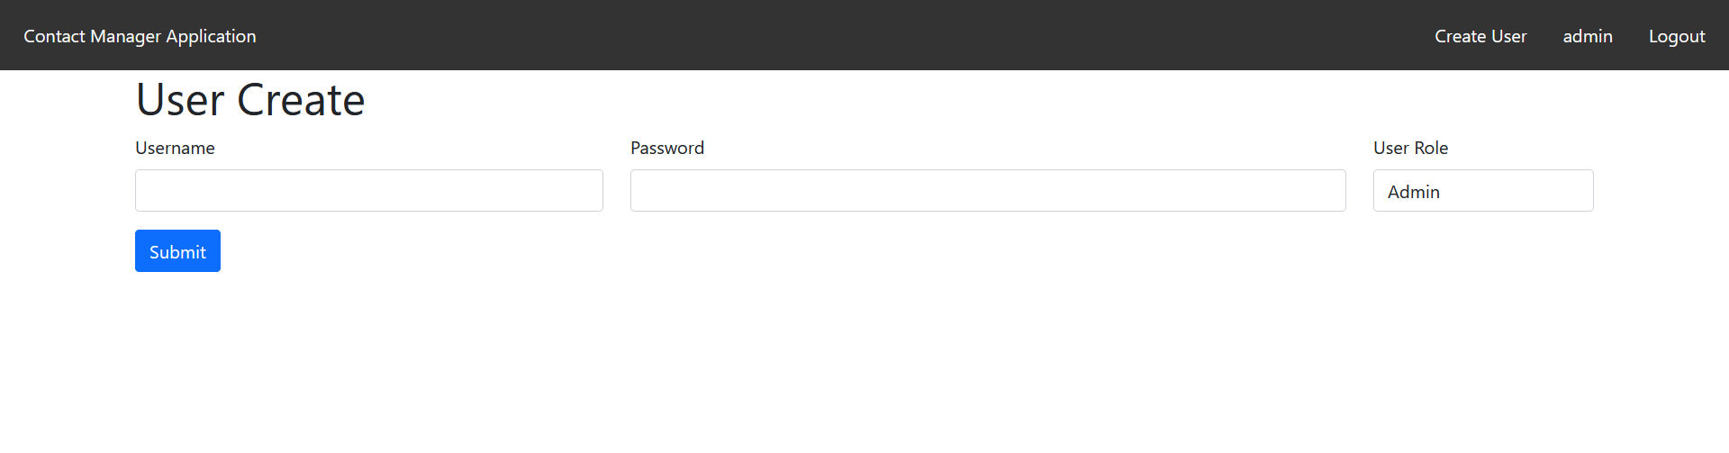
Adding new users
We can add new users from here, set their initial password and mention their roles while adding them for the first time. This is for setting the login information for a user.

Slide 9
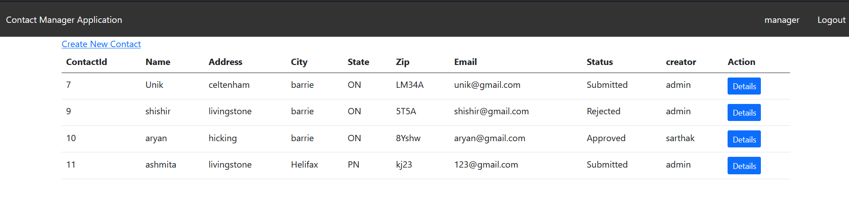
Manager Page
This page shows the user details which have ‘manager roles’ assigned to then and their details as per the database. It also shows the status of the user, and if it has been approved/rejected by the admin.

Slide 10
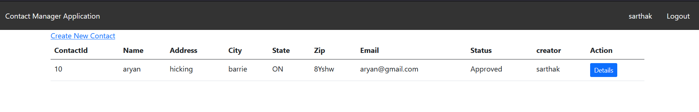
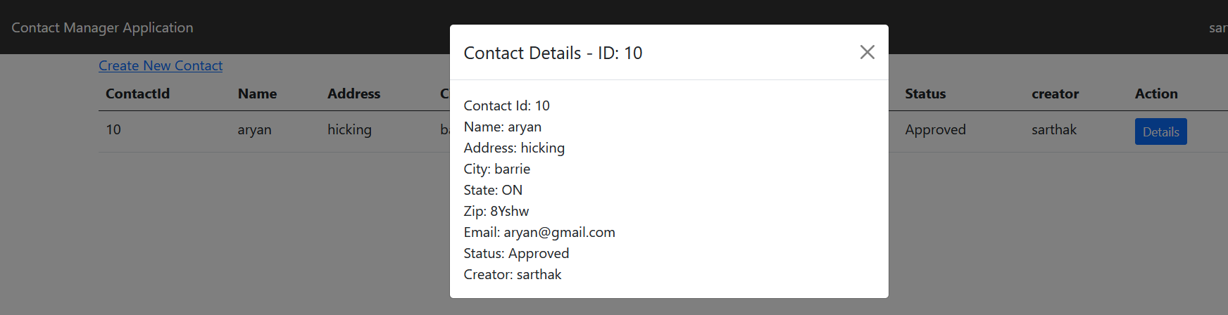
Registered User

Slide 11
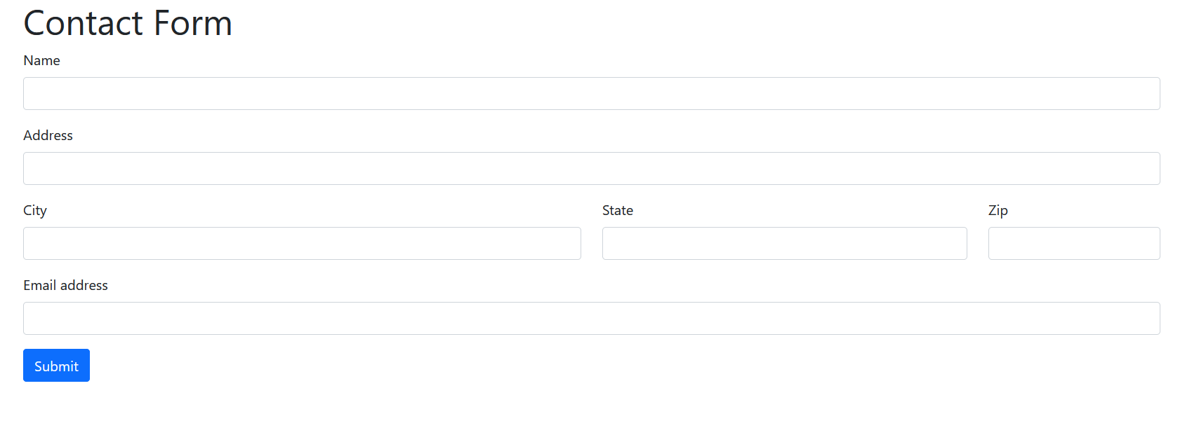
Contact Form
This is the contact form, where we can put in database information for any new user, it asks for basic information of the new user, i.e.
Name, Address (City, State, Zip) and Email address.

Slide 12
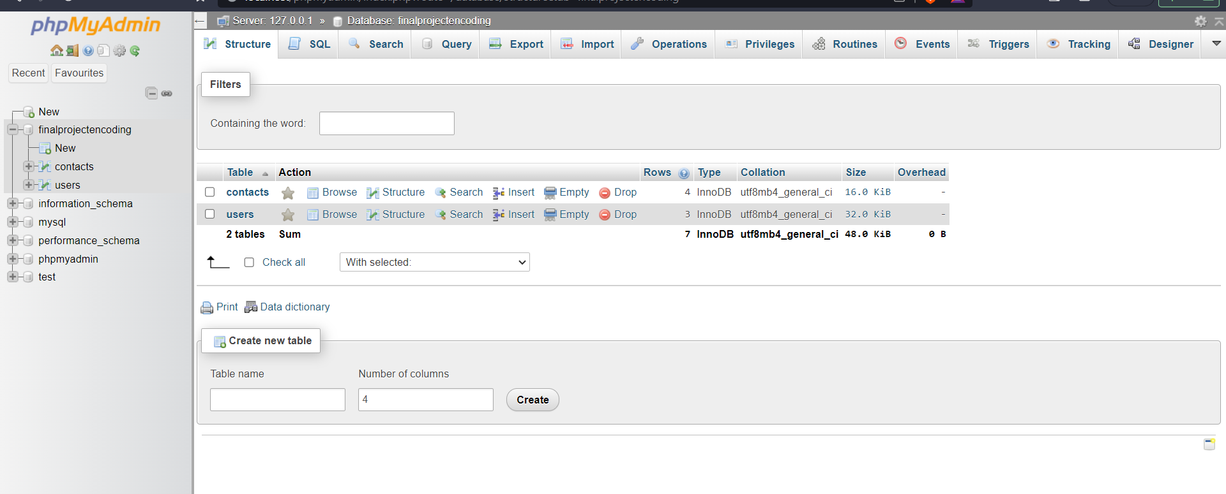
SQL Table
The database two different tables for users, and contacts which contain the user and contact information respectively.

Slide 13
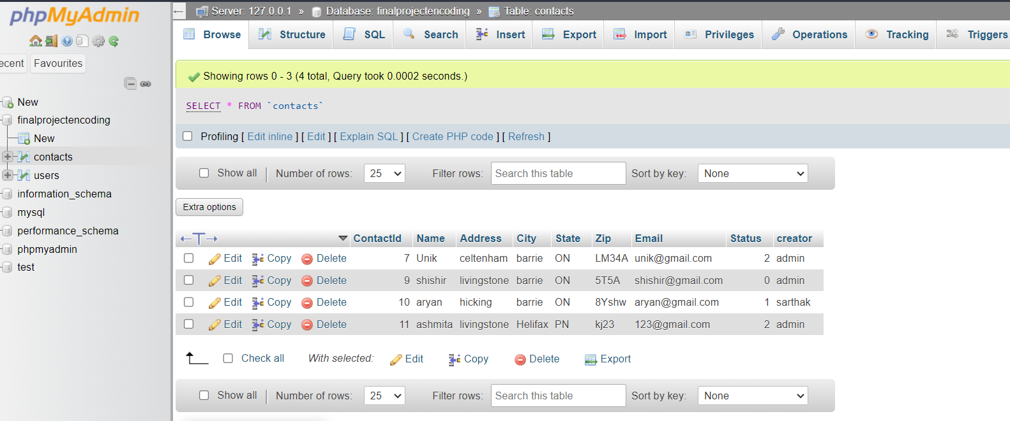
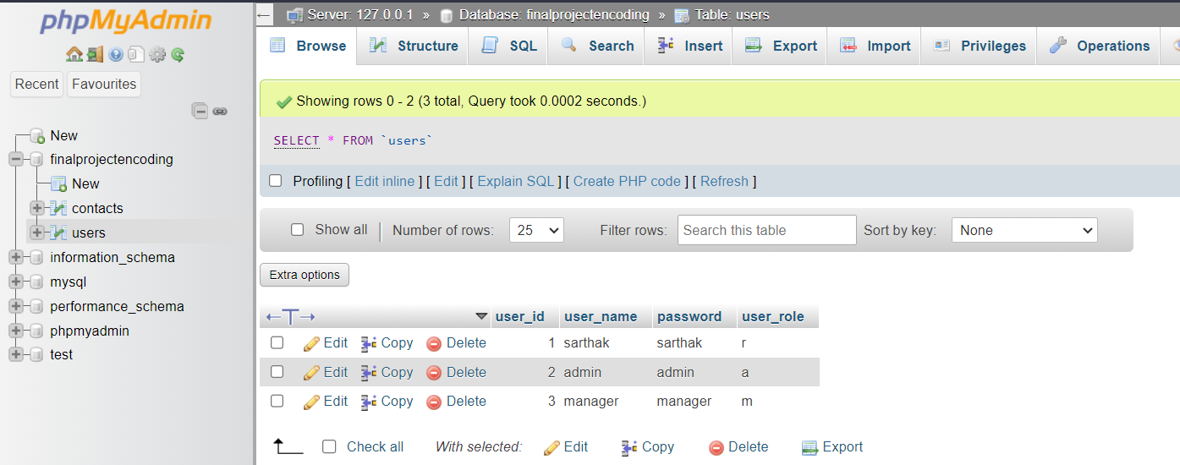
Contact Table
Shows 4 observation of contact information of users.
Users Table
Shows 3 observations of user’s username and password along with their roles.

Slide 14
Thank You

